Slide 1

Cost Optimization in Hybrid Multi-Cloud Architectures: A Study of Cloud Pricing Models, Sky Computing, and API-Driven Cost Control
By :
Shiva Kumar Biru
Examiners: Prof. Henry-Nobert Cocos, Prof. Dr. Christian Baun
Date: 13.08.2025

Slide 2
Motivation
Cloud adoption is growing, but managing costs across providers is complex.
Hybrid and multi-cloud strategies introduce hidden costs and vendor lock-in risks.
Sky Computing promises portability and cross-provider cost optimization.
Notes:
Over the past decade, cloud adoption has grown rapidly. Organizations are now combining on-premises systems with multiple cloud providers to gain flexibility, improve resilience, and avoid vendor lock-in. This approach — called hybrid and multi-cloud — allows them to use the strengths of each platform.
But while the architecture is flexible, cost management becomes a serious challenge. Each cloud provider has different pricing models — On-Demand, Reserved Instances, and Spot pricing — each with its own terms, discount options, and billing practices. Choosing the right option for each workload is essential to avoid unnecessary spending.
The challenge is even greater when costs are spread across multiple platforms. Beyond the standard compute and storage charges, companies face hidden costs — like data ingress and egress fees, cross-region transfer charges, unexpected API call costs, and expenses from idle resources. And for hybrid setups, the on-premises side still brings ongoing costs like power, cooling, hardware depreciation, and maintenance.
To address this, my research looks at cost optimization strategies, and cost control APIs. These APIs help track real-time usage, analyze spending patterns, and even automate cost-saving actions.
I also explore Sky Computing, a newer approach designed to break down the barriers between providers, so workloads can automatically run on whichever platform is most cost-efficient at the time. While this promises better flexibility and savings, it also adds orchestration complexity that needs careful management.
Methodologically, I use a Systematic Literature Review to study cloud pricing models, cost optimization in hybrid cloud ,and the cost control API’s and Sky Computing’s potential. Then, I develop a prototype tool that compares compute costs across AWS, Azure, and GCP. The goal is to give organizations a practical way to identify the most cost-effective provider for their workloads.
Ultimately, this work aims to bridge the gap between theory and practice — helping organizations control costs while retaining the flexibility that hybrid and multi-cloud environments offer."

Slide 3
Objectives & Research Questions
Goal: Analyze pricing models, study APIs, evaluate Sky Computing, and build a prototype.
RQ1: What pricing models exist and what hidden costs arise?
RQ2: How can APIs help automate cost control?
RQ3: How does Sky Computing influence cost strategies?

Slide 4
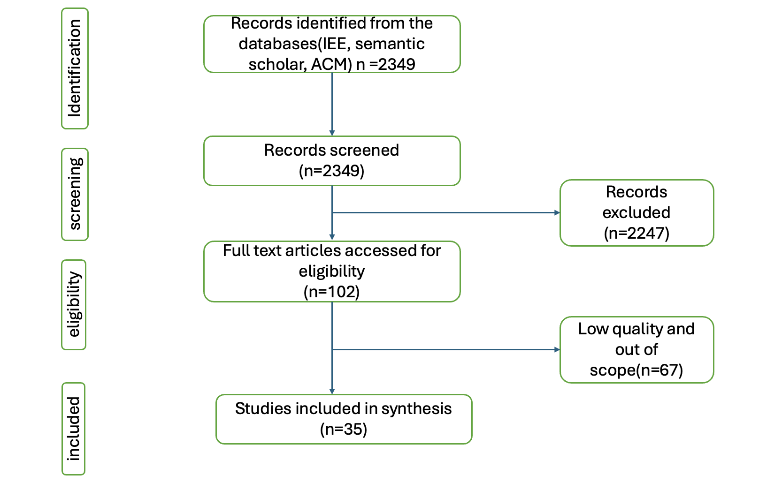
Methodology
Method: Systematic Literature Review (SLR) following Carrera-Rivera et al. framework.
Process: Planned review using PICOC framework → searched IEEE, ACM, Semantic Scholar → applied inclusion/exclusion criteria.
Quality Assessment: Studies scored on reporting, rigor, credibility, and relevance (threshold ≥ 7) to ensure methodological soundness; QA reduced the pool from 35 to 19 high-quality papers and extracted & synthesized data.
Outcome: 19 final high-quality studies (from 2,349 initial records) used for synthesis and analysis.
Notes:
For the methodology, I followed a structured Systematic Literature Review, based on the Carrera-Rivera framework, to ensure transparency, consistency, and reproducibility.
First, in the planning phase, I defined research questions using the PICOC framework, selected key databases like IEEE Xplore, ACM, and Semantic Scholar, set inclusion and exclusion criteria, created a quality assessment checklist, and designed a data extraction form.
Next, in the review phase, I built Boolean-based search strings from PICOC keywords, ran searches across the databases, removed duplicates, screened titles and abstracts, and then assessed full texts. Inclusion was based on criteria such as publication date, focus on AWS, Azure, GCP, hybrid or multi-cloud, and relevance to pricing or cost optimization.
From 2,349 initial papers, screening and quality checks reduced this to 19 high-quality studies. The quality assessment scored papers on reporting, rigor, credibility, and relevance, with a threshold of 7 out of 8 points.
I then used a structured data extraction form to collect key details such as title, authors, year, main findings, and research gaps.
Finally, in data synthesis, I analysed these studies to identify patterns, compare approaches, and generate insights to answer the research questions.

Slide 5
Analysis of Pricing Models: AWS, Azure, GCP
Aim: Analyse available pricing models in AWS, Azure, and GCP, and compare their pricing for equivalent general-purpose VCIs across regions.
Regions: Virginia (USA) vs Frankfurt (Germany).
Instances: AWS t3a.2xlarge, Azure Standard D8as v5, GCP n2-standard-8.
Pricing Models: On-Demand, Reserved/Savings Plans/Committed Use Discounts, Spot Instances.
Key Findings:
1. Pricing Model Insights
Long-term commitments (Reserved Instances, Savings Plans, Committed Use Discounts) offer significant savings vs On-Demand
On-Demand: Maximum flexibility, highest cost
Spot Pricing: Steepest discounts (up to 90%).
2. Regional Differences
Frankfurt is consistently more expensive than Virginia across AWS, Azure, and GCP.
Regional cost gap ranges:
AWS: +14–43%
Azure: +20–56%
GCP: +14–31%
Conclusion: Selecting the right region can save more and also choosing the most discounted plan as per our requirement.
Notes:
In the related work, I examined how pricing models vary across the three major cloud providers — AWS, Azure, and GCP — focusing on general-purpose virtual compute instances, or VCIs, in two regions: Frankfurt and Virginia.
The goal was to address a gap in real-time, empirical comparisons using official pricing calculators, because cloud costs are influenced by factors like region, instance type, and commitment level.
For AWS, I compared Savings Plans, Reserved Instances, Convertible Reserved Instances, On-Demand, and Spot Instances. Frankfurt was consistently more expensive — about 14% to over 40% higher — with Spot Instances showing the biggest gap.
In Azure, I looked at Pay-as-you-go, Reservations, Savings Plans, and Spot pricing. Frankfurt again cost more across all models, with the steepest increase in 1-year Savings Plans — over 56% higher than Virginia.
For GCP, I analyzed Pay-as-you-go, Committed Use Discounts, Sustained Use Discounts, and Spot VMs. Regional price gaps ranged from 14% to 31%, again with Spot instances showing the largest difference.
The key takeaway is that while all providers offer significant discounts through long-term commitments or Spot pricing, region selection is just as critical. Even with the same plan, Frankfurt pricing was consistently higher, which can outweigh discount benefits.
Overall, AWS offers the broadest set of flexible pricing models, Azure has strong savings plans but less convertibility, and GCP keeps it simpler with automatic sustained discounts. But across all three, combining the right pricing model with the right region is essential for cost optimization.

Slide 6
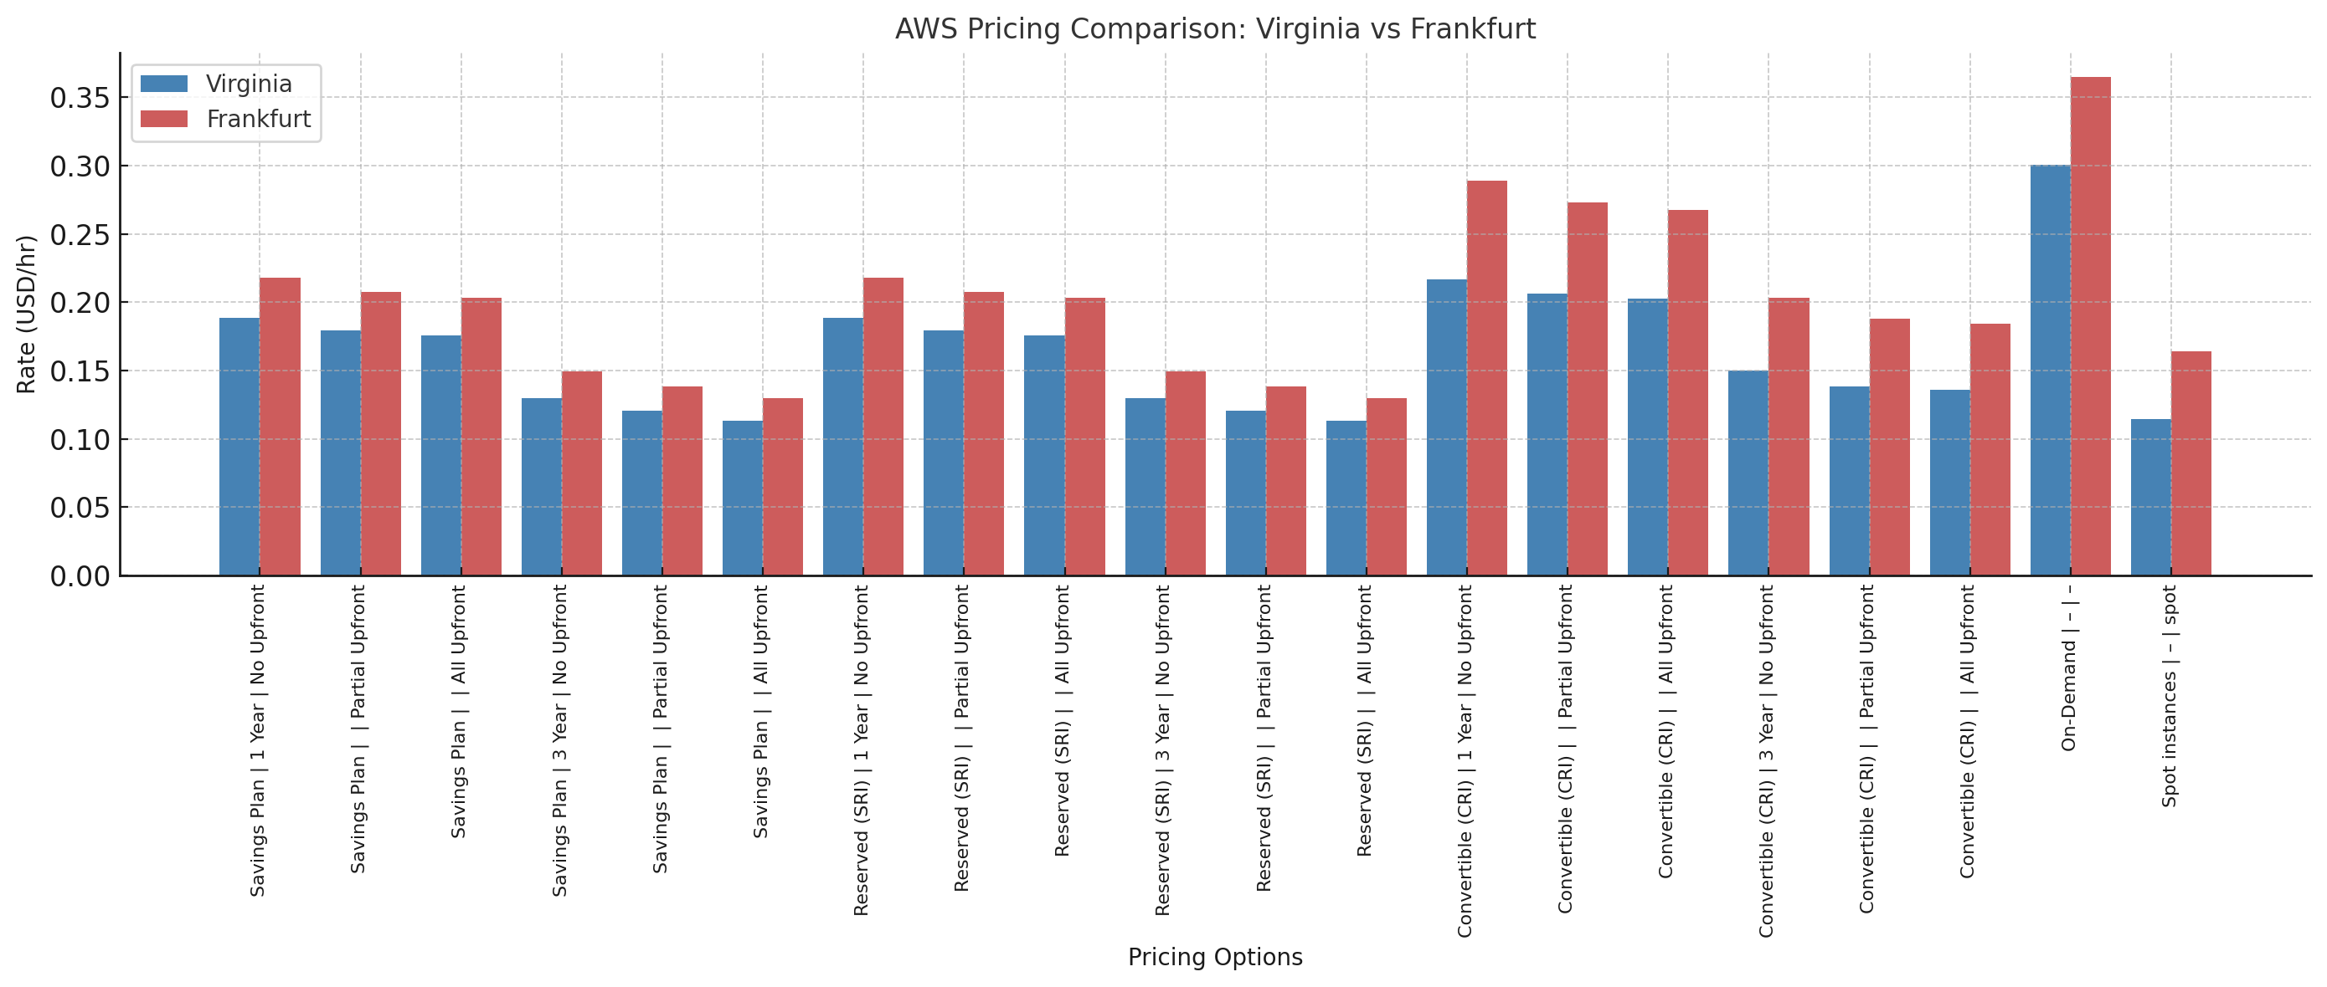
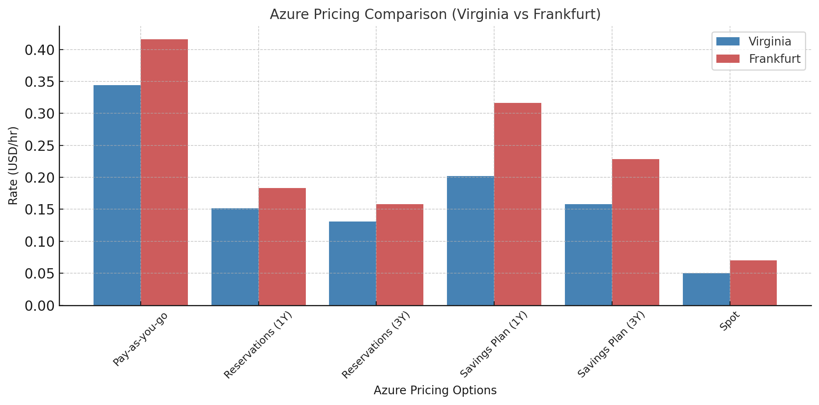
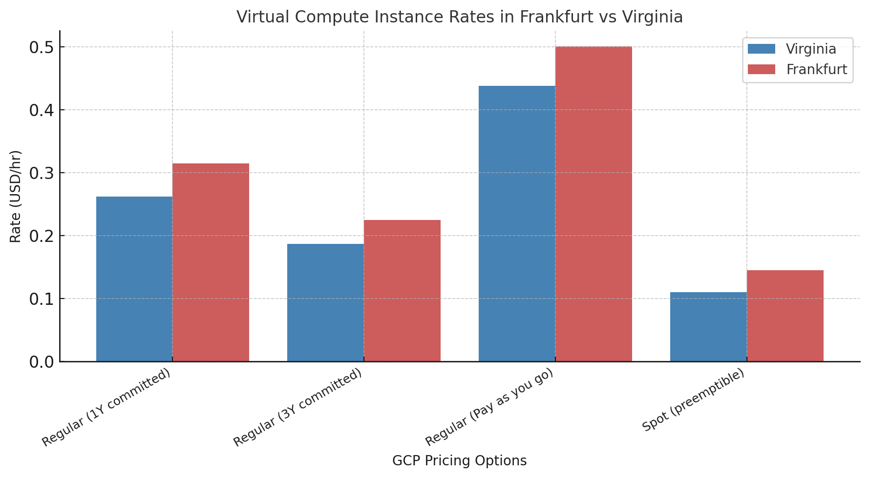
VM Cost Insights Across AWS, Azure, GCP
Notes:
In cloud computing, we often focus on compute and storage costs, but there’s another major factor — data transfer costs, especially when moving data out of the cloud, known as egress. This can become a hidden but significant expense in hybrid or multi-cloud setups where data moves across regions or platforms.
When we compare the three major providers — AWS, Azure, and GCP — data ingress is free in all cases, but egress pricing varies a lot. For example, in the Frankfurt region, AWS can charge as low as two cents per gigabyte when sending to another AWS region, but sending to the internet can go up to nine cents per gigabyte. Azure gives you some free allowances — the first 100 gigabytes to the internet are free — and then charges around 7 to 8 cents per gigabyte. GCP, depending on whether you use their Premium or Standard network tier, can range from about six cents to eleven cents per gigabyte, with the Standard tier being cheaper but offering slightly lower performance.
Now, when we compare on-premises infrastructure to the cloud, the differences are clear. An on-prem setup with equivalent compute power requires about $3,600 upfront for hardware and rack facilities, plus around $14,900 over three years for electricity, cooling, and real estate — that’s a total cost of ownership of about $18,500 over three years.
For the same workload in Frankfurt over three years, AWS comes in at around $8,100, Azure about $8,900, and GCP about $11,300. That means AWS can be around 56% cheaper than on-prem, Azure about 52% cheaper, and even GCP — the most expensive — is still 39% cheaper.
And beyond cost, the cloud offers operational benefits: you can scale resources instantly without buying new hardware, you don’t have to maintain physical infrastructure, staffing needs are reduced, and you get higher reliability thanks to built-in redundancy and backup options.
So, in short — cloud generally beats on-prem in cost over a multi-year period, but managing data transfer costs carefully is essential, especially for global or high-volume workloads.

Slide 7
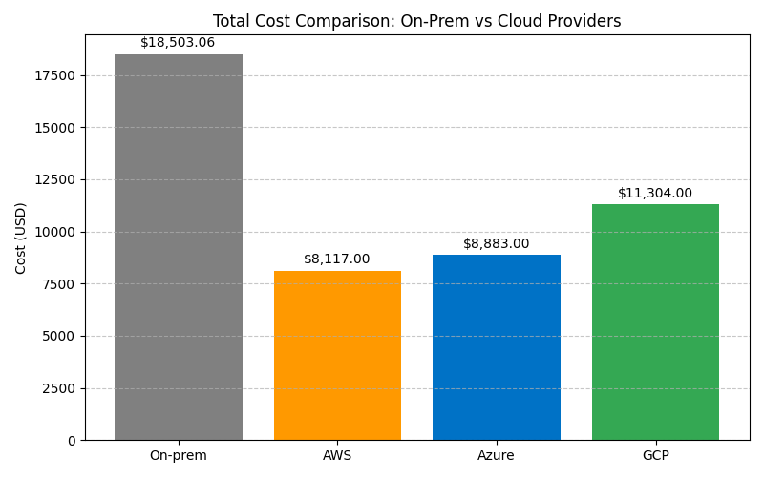
Data Transfer & On-Premise vs Cloud Costs
AWS: Ingress free; intra‑region $0.01/GB (each way); inter‑region $0.02/GB – 0.08/GB ; Internet $0.05–0.09/GB; CloudFront egress free.
Azure: Ingress is free, plus 5 GB/month inter-region and 100 GB/month Internet egress are free; beyond that, inter-region traffic costs $0.02–$0.05/GB depending on destination, and Internet egress is $0.09/GB.
GCP: Ingress and intra-zone transfers are free; inter-zone transfers within the region cost $0.01/GB; inter-region outbound costs are 0.02 – 0.11 and Premium-tier Internet egress are $0.11/GB, while Standard-tier Internet egress is cheaper at $0.065/GB.
On‑prem vs Cloud (3‑yr TCO, Frankfurt) On‑prem ≈ $18.5k (CapEx $3.6k + OpEx $14.9k). Cloud totals: AWS $8.1k (−56%), Azure $8.9k (−52%), GCP $11.3k (−39%).
Notes:
In cloud computing, we often focus on compute and storage costs, but there’s another major factor — data transfer costs, especially when moving data out of the cloud, known as egress. This can become a hidden but significant expense in hybrid or multi-cloud setups where data moves across regions or platforms. AWS Intra region ( within Frankfurt EC2 ⇄ S3 / Other Services )
Inter-region (outbound) – 0.02 /GB in EU
0.08 per GB from Frankfurt to Asian countries
$0.05 per GB – Canada /Mexico countries
GCP
Premium and standard
Intra-Zone
Within Zone
Same zone (internal IP) Inter-Zone (same region)
Internal
Same region (e.g., zone-a → zone-b)
$0.01 per GiB
Now, when we compare on-premises infrastructure to the cloud, the differences are clear. An on-prem setup with equivalent compute power Intel® Xeon® E-2468 processor, which features 8 cores . This is paired with 32 GB of ECC DDR5 RAM, a 2TB SATA hard disk drive, The system is a 9U rackmount chassis and includes essential components such as a power distribution unit (PDU), KVM switch, and cabling for deployment in a standard data center environment.
requires about $3,600 upfront for hardware and rack facilities, plus around $14,900 over three years for electricity, cooling, and real estate — that’s a total cost of ownership of about $18,500 over three years.
For the same workload in Frankfurt over three years, AWS comes in at around $8,100, Azure about $8,900, and GCP about $11,300. That means AWS can be around 56% cheaper than on-prem, Azure about 52% cheaper, and even GCP — the most expensive — is still 39% cheaper..
And beyond cost, the cloud offers operational benefits: you can scale resources instantly without buying new hardware, you don’t have to maintain physical infrastructure, staffing needs are reduced, and you get higher reliability thanks to built-in redundancy and backup options.
So, in short — cloud generally beats on-prem in cost over a multi-year period, but managing data transfer costs carefully is essential, especially for global or high-volume workloads.

Slide 8
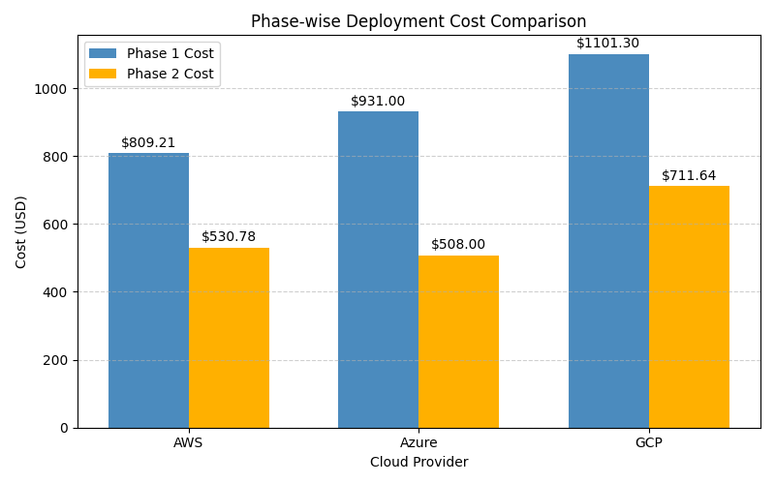
Cost Optimization
ML-based Web Application Webserver (always on) ML training (periodic, high compute) Load Balancer & Storage Phase 1: All resources are provisioned using On-Demand, including those used for model training. Phase 2: A cost-optimized mix of Reserved(equivalents), On-Demand/Pay-as-you-go/Regular, and Spot instances is used to better align infrastructure costs with workload patterns. Outcome: 30–45% cost reduction without sacrificing performance or availability. Predictable workloads → Reserved. Variable workloads → On-Demand. Flexible/non-critical → Spot.
Notes:
optmization techniques: dynamic resource scheduling and provisioning
optimizing storage costs
Workload placement strategies
carefully choose instance types and purchase options
Migration and refactoring strategies
use of AI and automation
i have choosen the right mix of instance types—Reserved, On-Demand, and Spot—based on workload patterns.
Use Case: We considered a machine learning web application architecture with an always-on webserver, compute-intensive training jobs, and cloud storage, all behind a load balancer.
Phase 1 – Baseline: We simulated the costs of running all components on On-Demand instances using the official pricing calculators from AWS, Azure, and GCP. While this model offers flexibility and reliability, it is more expensive—monthly costs came out to about $809 for AWS, $931 for Azure, and $1,101 for GCP.
Phase 2 – Optimized: We then modeled a cost-optimized mix:
Reserved Instance for the always-on webserver (lowest cost for stable workloads).
On-Demand for burst capacity or failover.
Spot Instance for non-critical training tasks (up to 90% cheaper).
Results: This simulation showed potential monthly savings of 34% for AWS, 45% for Azure, and 35% for GCP, without reducing availability or performance in the assumed architecture.
Conclusion: Even without a real deployment, this simulation shows how mapping stable workloads to Reserved, using On-Demand for flexibility, and assigning flexible workloads to Spot instances can significantly cut infrastructure costs in hybrid cloud setups.

Slide 9

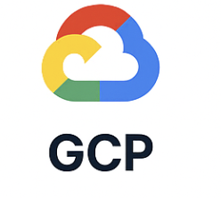

Application Programming Interfaces
Cost Explorer | Retail Prices & Price Sheet | Cloud Billing Budget
Budgets | Budgets & Alerts | Cloud Pricing API
Cost and Usage Report | Reservations | Cloud Billing Accout & Catalog
Cost Optimization Hub | Exports & Cost Details
Price List
All three cloud providers (AWS, Azure, GCP) offer APIs to monitor usage, manage budgets, retrieve pricing.
Key Benefits:
Automate cost tracking and reporting.
Set budgets with alerts to prevent overspending.
Access real-time or account-specific pricing for accurate forecasting.
Export detailed usage data for BI and cost analysis.
Notes:
Cloud computing is scalable and flexible, but this often results in unpredictable costs. Manual tracking is insufficient, so cloud cost control relies on APIs to monitor usage, enforce budgets, and optimize spending in real time.
2. AWS Cost Control APIs AWS provides several APIs for cost management:
Cost Explorer API – Analyze, forecast, detect anomalies, and rightsize resources.
Budgets API – Set cost/usage limits and trigger alerts or actions.
Cost Optimization Hub API – Centralized savings recommendations.
Cost & Usage Report (CUR) API – High-detail CSV reports for analysis.
Price List API – Real-time service pricing data. These can be accessed via AWS CLI, SDKs like Boto3, and integrate with dashboards and automation scripts.
3. Azure Cost Control APIs – 45 seconds Azure groups its cost APIs into:
Cost Details APIs – Export and generate usage data for dashboards.
Pricing APIs – Public retail prices and custom enterprise price sheets.
Budgets & Alerts APIs – Define budgets and trigger alerts.
Reservation Management APIs – Recommend long-term commitments to save costs. Azure supports access via REST, CLI (az consumption), and SDKs in Python, Node.js, etc.
4. GCP Cost Control APIs – 45 seconds GCP offers:
Cloud Billing Budget API – Set budgets, monitor spend, and send alerts via Pub/Sub.
Cloud Pricing API – Public and account-specific service prices.
Billing Account & Catalog APIs – Manage billing accounts, retrieve SKUs, and price details. Like AWS and Azure, these are accessible via REST, SDKs, and client libraries in Python, Java, and more.
5. Closing
Across all three providers, the goal of these APIs is the same: automate cost tracking, integrate with dashboards, enforce budgets, and identify savings opportunities. Mastering these APIs allows organizations to proactively manage cloud costs rather than react to billing surprises.

Slide 10
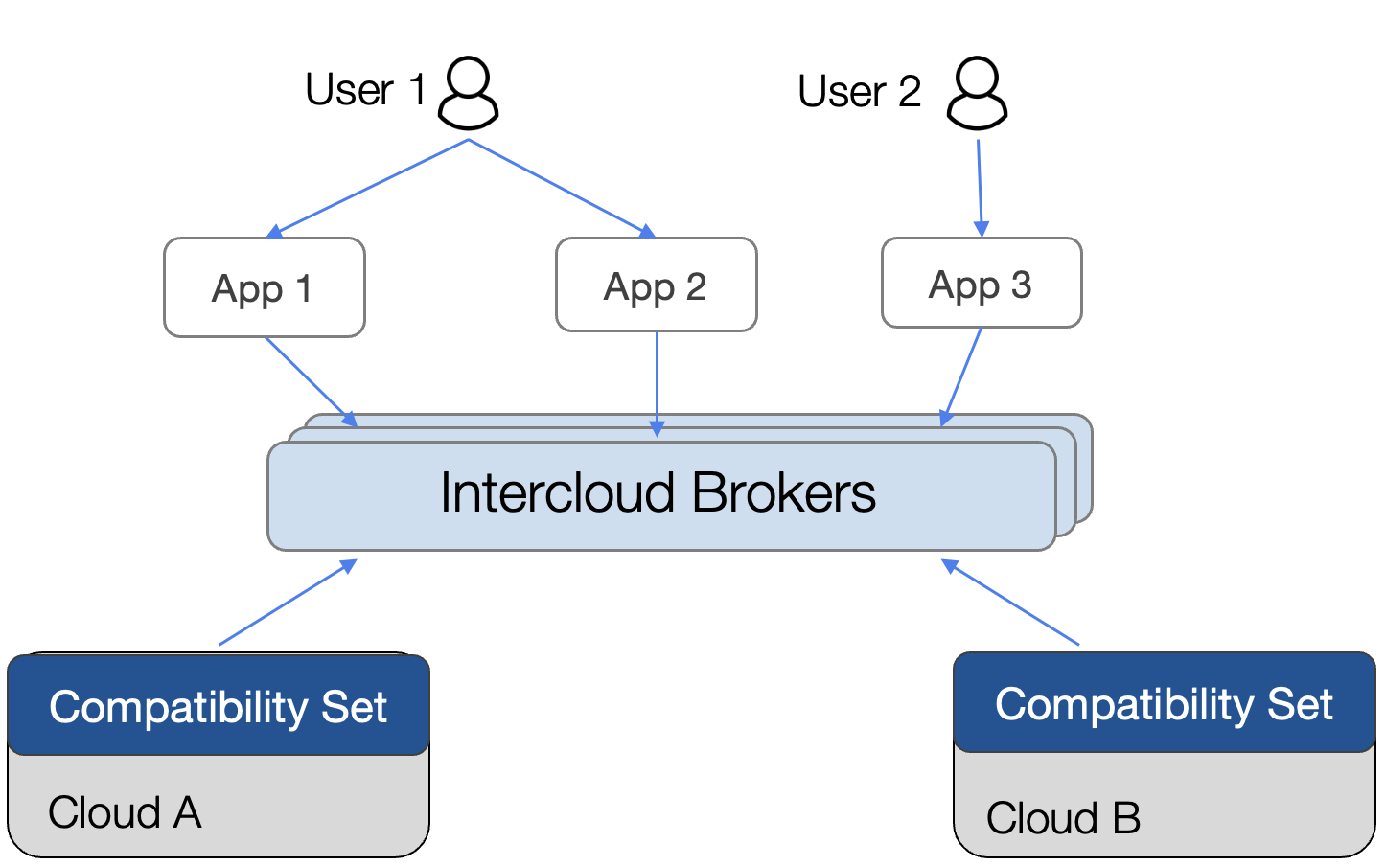
Sky computing
What It Is
Enables seamless, vendor-agnostic cloud usage
Inspired by utility computing – compute as a global utility
Architecture
Compatibility Layer – Open tools (K8s, Docker) enable portability
Intercloud Layer – Smart scheduling across clouds (cost/perf aware)
Peering Layer – Efficient cross-cloud data sharing (low egress)
Key Component: Intercloud Broker
Manages job placement, billing, data movement
Example: Sky Pilot optimizes ML pipelines across AWS, GCP, Azure → 80% cost savings
This Thesis Enables Sky Computing
Compares real-time costs, APIs, data transfer fees across AWS, Azure, GCP
Builds a live VM cost dashboard.
Notes:
What is Sky Computing “Today, using more than one cloud (like AWS, Azure, GCP) is hard. Each has its own rules, tools, and prices. Sky Computing is a new idea where all clouds work together like one big cloud, so you can run things wherever it’s cheapest or fastest.”
How it works (3 layers) “It’s built in 3 layers:
Compatibility Layer – common tools like Kubernetes or Docker make apps run on any cloud without changes.
Intercloud Layer – a smart system that finds the best cloud for your job based on rules
Peering Layer – cross‑cloud data peering to cut egress fees and speed data movement..”
The Intercloud Broker (the brain of the system) “In the middle is the Intercloud Broker. You just tell it your job and rules (like ‘keep cost low’). It:
Checks prices, hardware, and services on each cloud.
Picks the best place to run each part.
Moves your data where it’s needed.
Can even handle billing and error recovery automatically.”
Example: SkyPilot “SkyPilot is a real system from UC Berkeley. In one test, they split a job across 3 clouds: secure data prep on Azure, model training on GCP, and inference on AWS. This was 80% cheaper and 62% faster than running it all in one cloud.”
My thesis “My work supports Sky Computing by:
Comparing prices and hidden costs between AWS, Azure, and GCP.
Looking at APIs to track and control costs.
Building a live dashboard to find the cheapest VM across clouds. This helps make the Sky Computing vision possible—where you can run your jobs anywhere, easily and cheaply.”

Slide 11
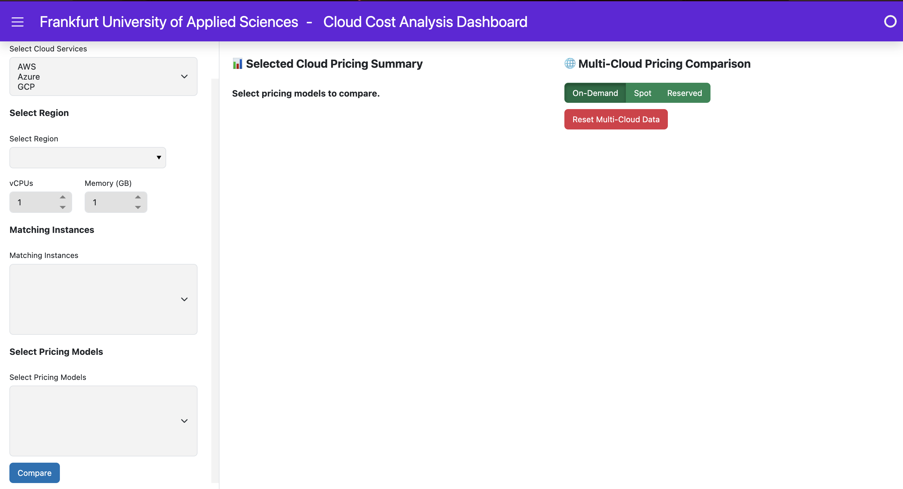
Prototype Demo
Notes:
AWS: Python SDK (boto3)
Azure: Direct REST API calls
GCP: Python SDK (googleapiclient)-- Google Cloud Billing Catalog API

Slide 12

Conclusion and Future scope
Conclusion
Compared cloud pricing models across AWS, Azure, GCP using real-time data
Identified major regional price gaps and hidden egress costs
Demonstrated that mixed pricing (Reserved + Spot + On-Demand) saves up to 45%
Built a live dashboard for VM cost comparison (Panel + cloud APIs)
Validated that cloud options are more cost-efficient than on-prem
Supports Sky Computing by enabling cross-cloud cost-awareness
Future Work
Extend comparison to GPU, memory-optimized, and PaaS/SaaS services
Include storage, networking, security, licenses in TCO analysis
Deploy real workloads across clouds to validate strategy impact
Expand dashboard: user inputs, broader services, smart recommendations
Evolve into an intelligent advisor for real-time multi-cloud cost optimization
Notes:
“This thesis looked at cloud pricing models and cost optimization strategies across AWS, Azure, and GCP.
We used two approaches — first, a literature review to understand pricing models like On-Demand, Reserved, Spot, and Hybrid; and second, real-time pricing analysis using provider APIs.
The results showed:
Big regional differences — for example, Azure’s Savings Plans in Frankfurt can be up to 56% more expensive than in Virginia.
Spot pricing gives large savings but is unpredictable and varies by region.
Data transfer costs matter — ingress is mostly free, but egress can be very expensive (e.g., AWS up to $92/TB from Frankfurt).
Comparing cloud to on-premises, all three cloud providers were cheaper over 3 years and offered better scalability and flexibility.
Using a mixed pricing strategy (On-Demand + Reserved + Spot) saved 30–45% compared to only On-Demand.
To make this easier to apply, I built a web dashboard that connects to AWS, Azure, and GCP APIs to show real-time VM pricing side-by-side. This helps users pick the cheapest option for their needs.
Overall, this work supports the Sky Computing vision by showing how understanding prices and hidden costs, plus using live data, can enable moving workloads to the most cost-effective cloud.”
Future Work (about 1 minute)
“In the future, this study could be expanded by:
Including more instance types — like GPU, memory-optimized, and compute-optimized — and more services like storage, databases, and networking.
Covering more global regions to see how pricing changes worldwide.
Making the on-premises vs. cloud comparison more complete by adding storage, networking, licensing, and staffing costs.
Testing strategies in real deployments using auto-scaling, load balancers, and spot instances, and measuring actual performance and reliability.
Improving the dashboard to accept user requirements like CPU, RAM, and region, and suggest the best instance across providers.
The long-term vision is to turn the tool into an intelligent cloud advisor that picks the cheapest and fastest option automatically — just like a Sky Computing broker would.”

Slide 13

Thank you

